Slide 1

AI Infrastructure
Ioannis Papapanagiotou
Cloud and On premises AI Infrastructure

Slide 2
Cloud vs on-premises AI Infrastructure
Navigating the cloud vs. on-premises dilemma for AI workloads requires a deep understanding of your
Data,
Budget
Performance requirements.
While the cloud offers flexibility and scalability, on-premises infrastructure provides control and cost-effectiveness, especially in the face of data gravity.
This session explores both, helping you make informed decisions tailored to your specific needs.

Slide 3
What is Cloud based AI Infrastructure
Cloud-based AI infrastructure utilizes remote servers hosted on the internet to manage and process data.
A Cloud vendor is hosting the compute, storage resources (data location) and in some cases you can also use AI/ML models running on the Cloud
This model offers flexibility and scalability, allowing organizations to access vast computational resources on-demand without significant upfront investment.

Slide 4
Pros of Cloud-based AI Infrastructure
Cost-Effective: Reduces the need for upfront hardware investment and ongoing maintenance costs.
Reducing CAPEX and increasing OPEX due to the Cloud providers charging a margin cost for each service they offer.
Scalability: Easily scales resources up or down based on demand.
Accessibility: Facilitates remote access, collaboration, and integration with various services.
Talent: An AI based application company can focus on acquiring talent in the area that they are competitive than hiring datacenter operations teams.

Slide 5
Cons of Cloud-based AI Infrastructure
Data Security: Potential vulnerabilities in data privacy and security.
While Cloud provide state-of-art security capability there is confusion on who owns the “security” of the platform
Internet Dependency: Relies heavily on internet connectivity, which can affect access and speed.
Latency Issues: Possible delays in data processing due to network lag.
This can be significant when you are loading significant sized data for training an AI model.

Slide 6

Cloud Security
Cloud Security Standards: Cloud providers do indeed adhere to high standards of security and often hold certifications like ISO 27001, SOC 2, etc. They invest heavily in securing their infrastructure with advanced security protocols, regular audits, and compliance checks.
Shared Responsibility Model: In the cloud, security is a shared responsibility between the provider and the customer.
While cloud providers secure the infrastructure, customers are responsible for securing their data and applications on the cloud. This division of responsibility can lead to vulnerabilities if customers do not adequately manage their part.

Slide 7

What is On-premises AI Infrastructure
On-premises AI infrastructure refers to the resources located within an organization's physical premises.
That is the resources are in a physical datacenter that is run with the company who is deploying AI applications.
This model offers complete control over the hardware and software environment, ensuring higher levels of security and customization.

Slide 8
Pros of On-premises AI Infrastructure
Complete Control: Full authority over the infrastructure, offering customization and optimization.
Security: Greater control over data security and compliance with regulatory requirements.
Network Performance: Reduced latency to transfer large amounts of data as the data are within the datacenter.

Slide 9
Cons of On-premises AI Infrastructure
Higher Initial Costs: Significant investment required for hardware purchase and setup.
Complexity in Management: Requires skilled personnel for ongoing maintenance and upgrades.
Limited Scalability: Expanding capacity can be costly and physically constrained.

Slide 10
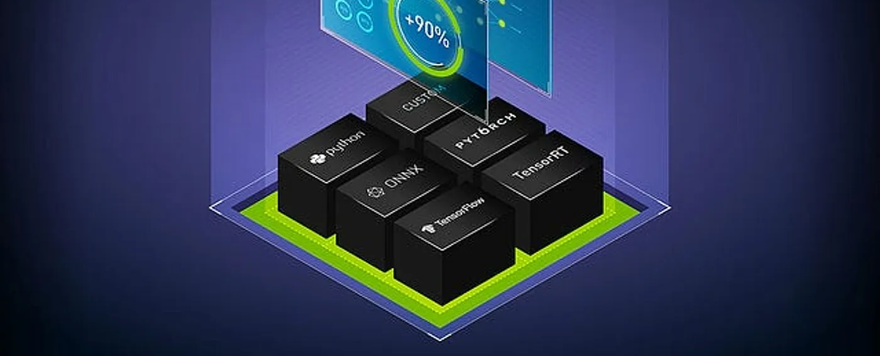
On Prem AI Infrastructure
In-house data center deployment cost can be high because a deployment of computation intensive systems with GPUs can require a lot of electricity, cooling, networking and expensive real estate.
While experimenting with AI, choosing the pay as you go options would save costs.
However, maintenance costs can increase over time.

Slide 11
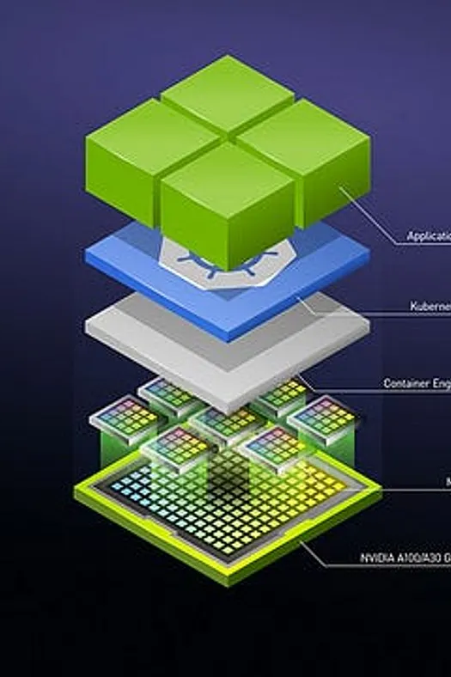
Scalability
On-premise hosting offers complete control over the hardware, which means that the administrators of a company can tightly control updates.
But on-premise hosting does require advanced planning to scale hardware.
This is because it requires time to gather the necessary data for updating it.
Cloud resources can be rapidly adjusted to accommodate specific demands and increase the scalability of hardware.
With cloud services, there is too much software clutter within the hardware stacks that reduces the scalability.

Slide 12
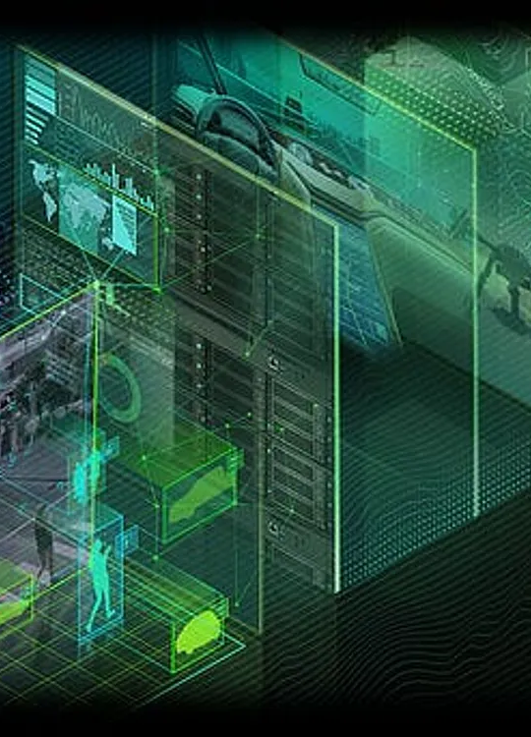
Data Gravity
Considering the costs of training neural networks with massive datasets for data transfer, companies may want to deploy their AI applications on-premises if the data is available there.
If the data required to build AI applications resides on the cloud, then it’s best to deploy applications there.
The location of the largest source of data for an enterprise determines the location of its most critical applications, as explained by the concept of ‘data gravity’.
Data gravity is the ability of data to attract applications, services, and other data towards itself. It is among the most important factors to be considered while choosing between cloud and on-premise platforms.

Slide 13
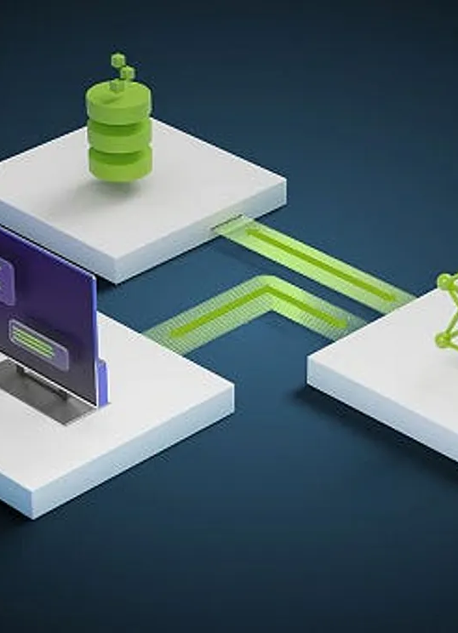
The Case for Cloud Based AI Applications
Cloud-based AI services are an ideal solution for many organizations. Instead of building out a massive data center to gain access to compute, you can use the infrastructure someone else already maintains.
In fact, one reason why AI has become so pervasive is cloud providers offering plug-and-play AI cloud services, as well as access to enough compute power and pre-trained models to launch AI applications.
This significantly reduces the barriers to entry.
In many cases the pre-trained models or storage requirements of the cloud can be cost-prohibitive; higher GPU counts get expensive fast and training large datasets on the public cloud can be too slow.
The cloud can often be the best option in terms of “testing the waters” of AI and experimenting with which AI initiatives work best for an organization.

Slide 14

The case for On premises AI
There’s a whole ecosystem of tools built for on-premise infrastructure that can work with mass amounts of compute power–which can be very expensive in the cloud.
Thus, some IT directors find it more economical to do this on-premise or prefer a capital expense to an operational expense model.
Furthermore, if your organization determines that it wants to get more involved in this or roll-out AI at scale, then it may make more sense to invest in on-premises infrastructure instead of consuming cloud-based services.

Slide 15
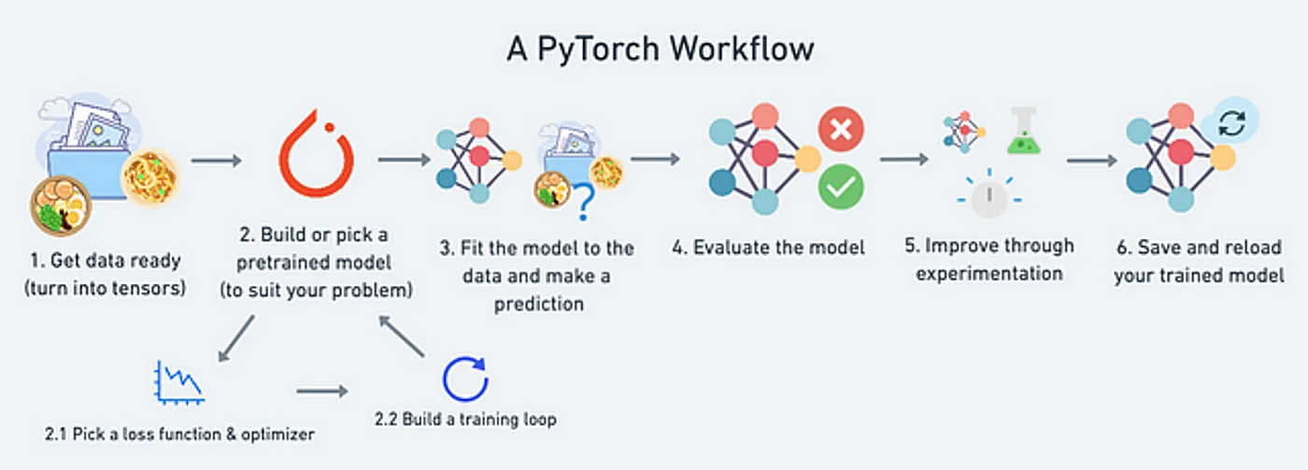
Challenges to Implementing AI
As you evaluate how to implement AI initiatives, it’s important to remember that much of the data driving AI is actually siloed in legacy infrastructure and is not necessarily in the right format nor is it easily accessible.
What’s more, there’s a massive amount of unstructured data to be processed!
And in many cases, that data has grown beyond a company’s infrastructure.
Dealing with much larger data sets requires more difficult computation and algorithms; the truth is, most of your time could be spent cleaning data, de-identifying it, and getting it to a point where it can be used to gather insights.

Slide 16
Comparing Cloud vs On-premises AI Infrastructure
Both cloud-based and on-premises AI infrastructures have their unique advantages and challenges.
The choice between them depends on specific project requirements, such as cost, scalability, security, and operational control.

